Slide 1
KEYNOTE ADDRESS:
SOCIAL AND ECONOMIC MOBILITY OF SOUTHERN MARYLAND
HARRY HOLZER
PROFESSOR OF PUBLIC POLICY AT GEORGETOWN UNIVERSITY’S MCCOURT SCHOOL OF PUBLIC POLICY
CONNECTING AND CONVENING

Slide 2
CAN THE COLLEGE OF SOUTHERN MARYLAND IMPROVE UPWARD MOBILITY FOR LOCAL RESIDENTS?
CONNECTING AND CONVENING

Slide 3
OVERVIEW
Background on upward mobility – Raj Chetty, Opportunity Insights
Mobility in Charles, Calvert, St. Mary’s counties
Role of community colleges in mobility: challenges and implications for policy/practice at CSM
CONNECTING AND CONVENING

Slide 4
MOBILITY
ABSOLUTE V. RELATIVE
ABSOLUTE Are children (as adults) better off than their parents? Needed: Widely shared economic growth e.g., postwar U.S. (JFK: Rising Tide Lifts All Boats)
RELATIVE Which income percentile/decile/quintile
are children in as adults,
conditional on parents –
relative to others
CONNECTING AND CONVENING

Slide 5
FOUR FACTS ABOUT MOBILITY IN AMERICA
Absolute mobility has declined over time - less broadly - shared growth and prosperity
Relative status of children: Depends heavily on parents! limited relative mobility - not “equal opportunity”
Upward mobility: Varies by race/gender
Upward mobility: Varies by geography
CONNECTING AND CONVENING

Slide 6
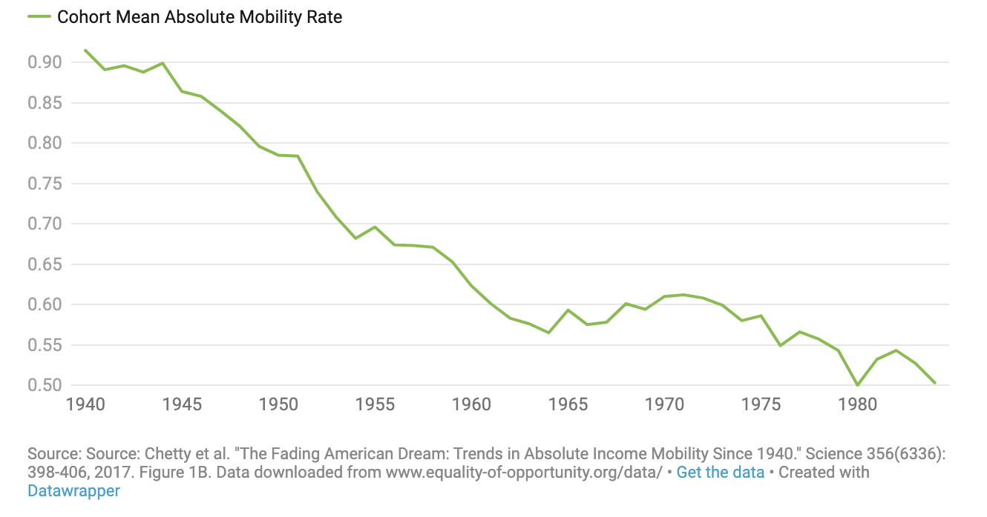
PERCENTAGE OF CHILDREN EARNING MORE THAN THEIR PARENTS, BY BIRTH COHORT
CONNECTING AND CONVENING

Slide 7
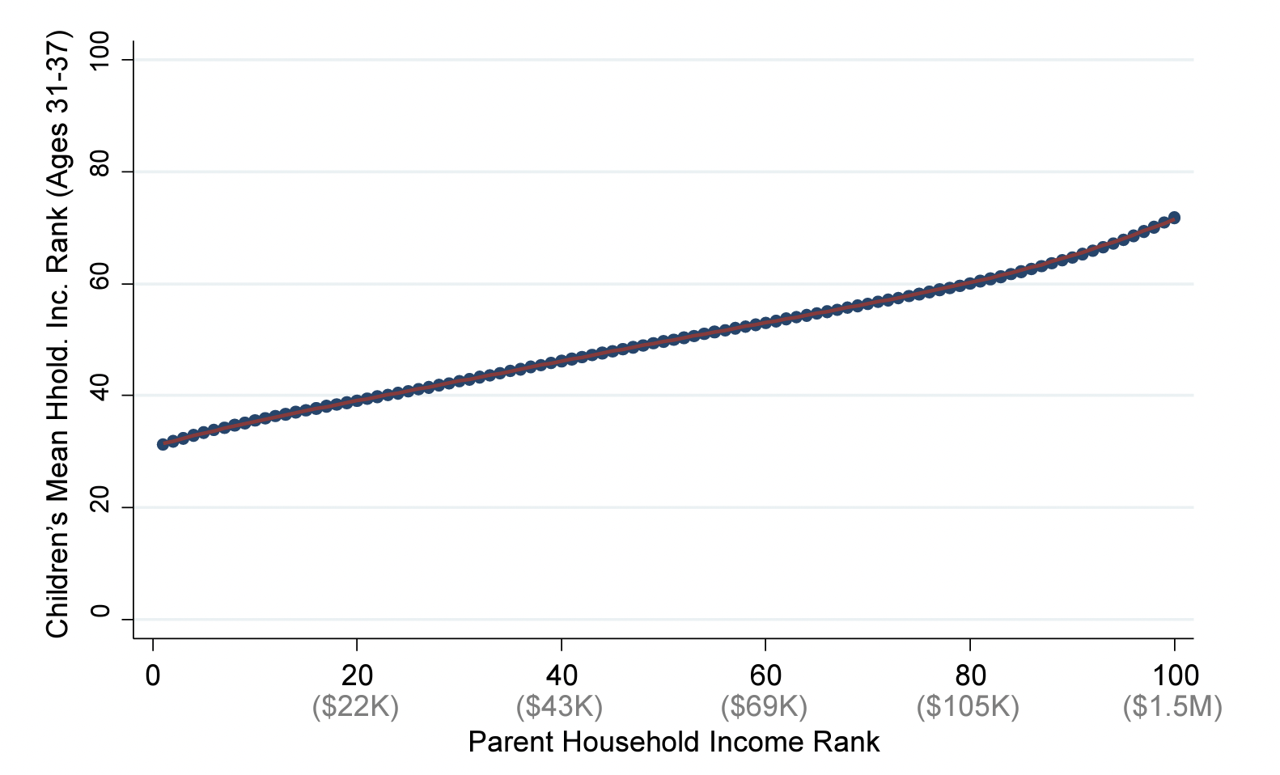
MEAN CHILD HOUSEHOLD INCOME RANK VS. PARENT HOUSEHOLD INCOME RANK
CONNECTING AND CONVENING

Slide 8
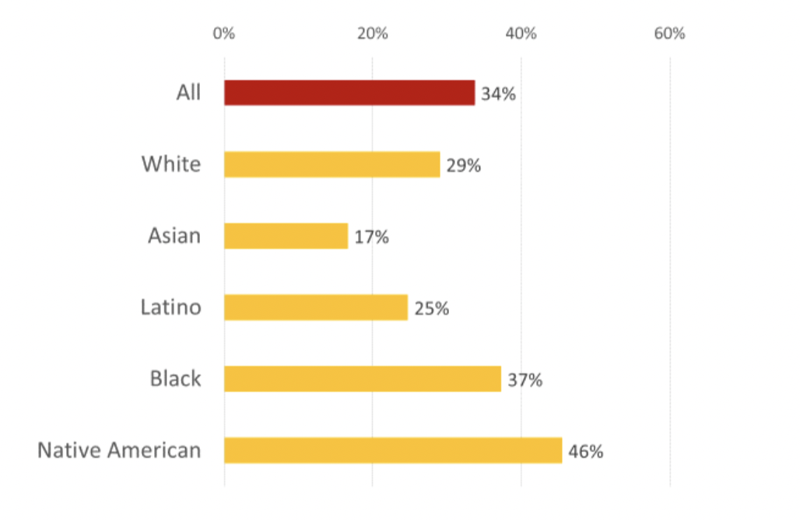
INTERGENERATIONAL PERSISTENCE OF LOW-INCOME STATUS, BY RACE
CONNECTING AND CONVENING

Slide 9
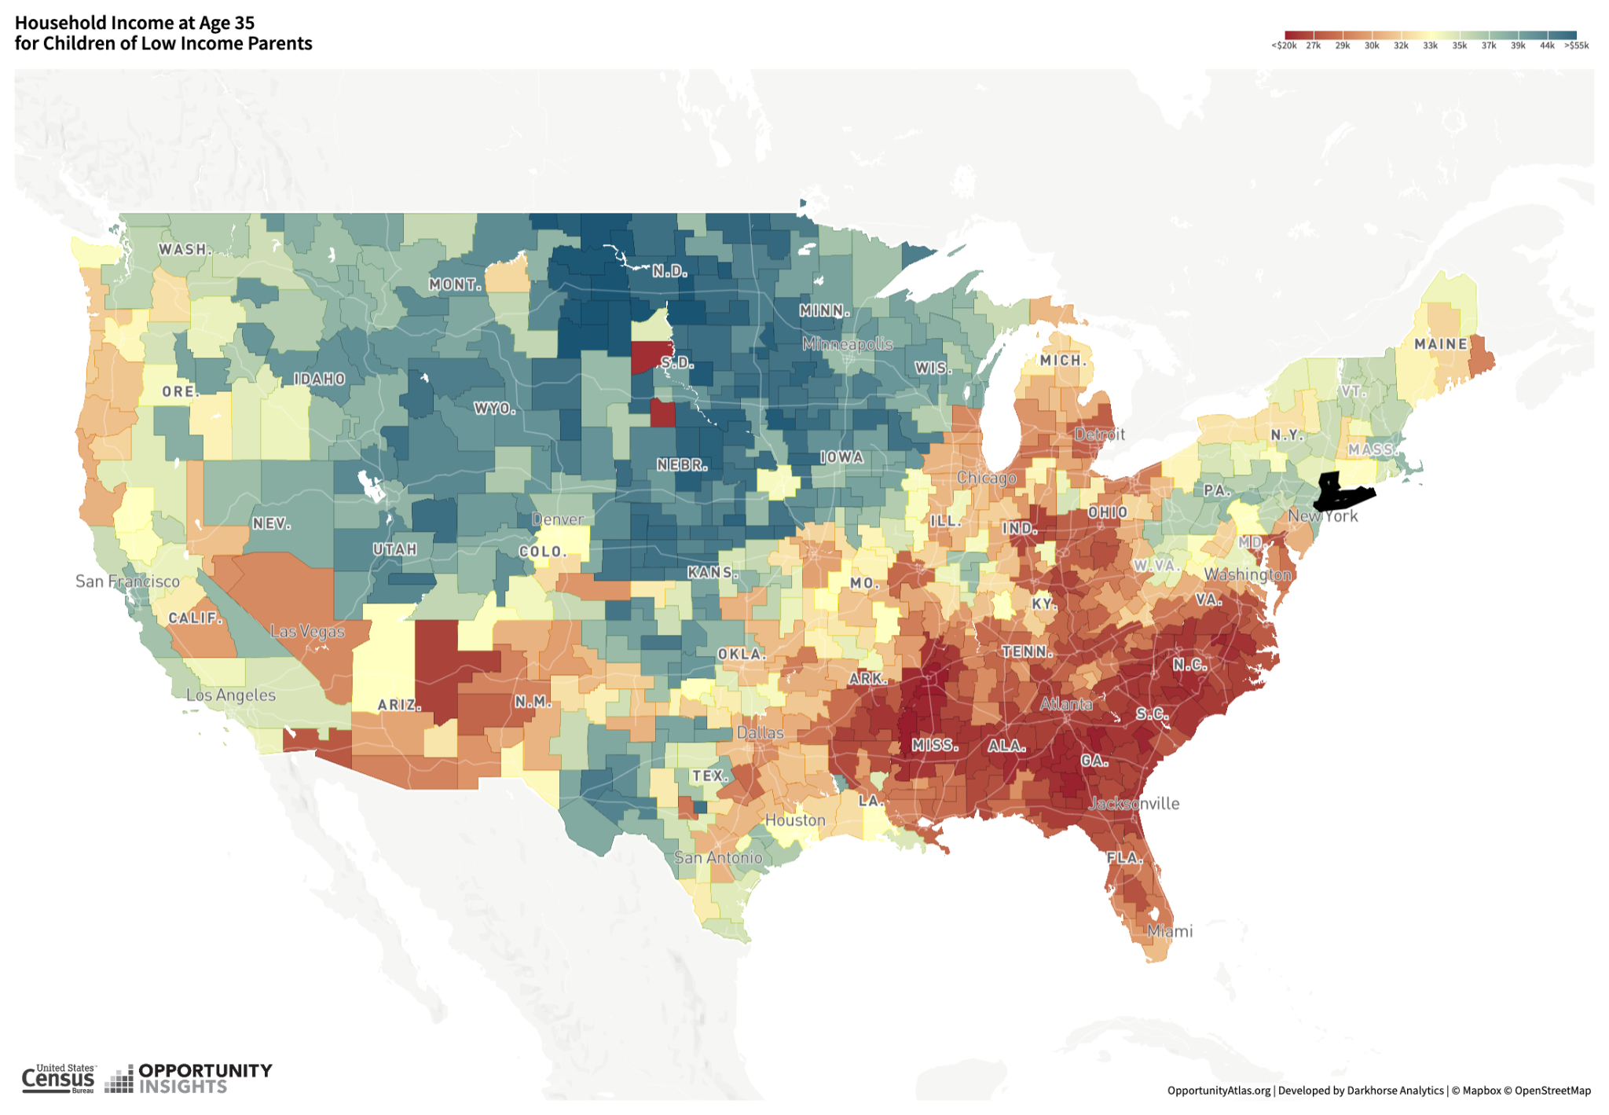
CONNECTING AND CONVENING

Slide 10
MOBILITY FACTS FOR CHARLES, CALVERT, ST. MARY’S COUNTIES
Demographics and income of each county
Geography of child mobility (at age 35) in each county
Child mobility facts by race/gender in each county
Sources: U.S. Census Bureau; Opportunity Insights Atlas of Opportunity
CONNECTING AND CONVENING

Slide 11
COUNTY CHARACTERISTICS
 | Calvert | Charles | St. Mary’s
Percent Black | .14 | .53 | .16
Percent BA+ | .36 | .31 | .33
Median Household Income | $120 | $108 | $103
Individual Income | 50.5 | 44.5 | 44
CONNECTING AND CONVENING

Slide 12
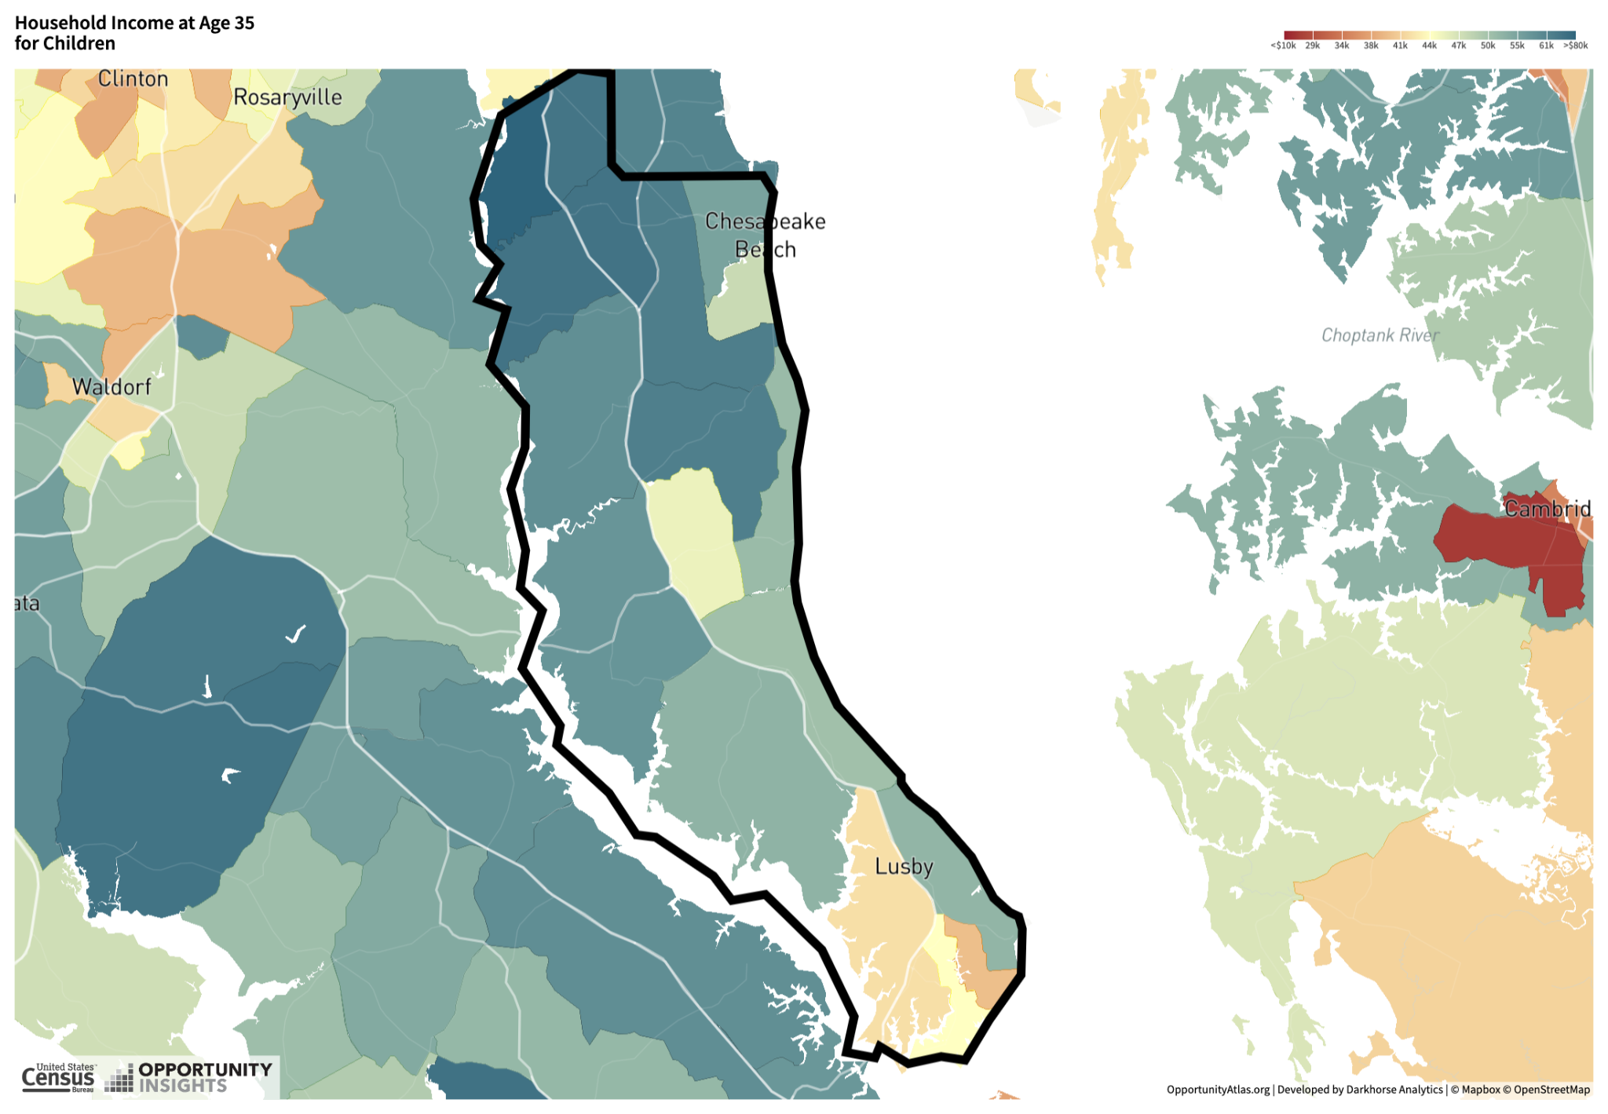
CALVERT COUNTY INCOME MOBILITY
CONNECTING AND CONVENING

Slide 13
CALVERT COUNTY
CHILDREN AT AGE 35 OF PARENTS WITH MIDDLE INCOME
 | White | Black Male | Black Female
Percent BA+ | .30 | .18 | .19
Household Income | $47,000 | $32,000 | $38,000
Individual Income | $31,000 | $28,000 | $31,000
CONNECTING AND CONVENING

Slide 14
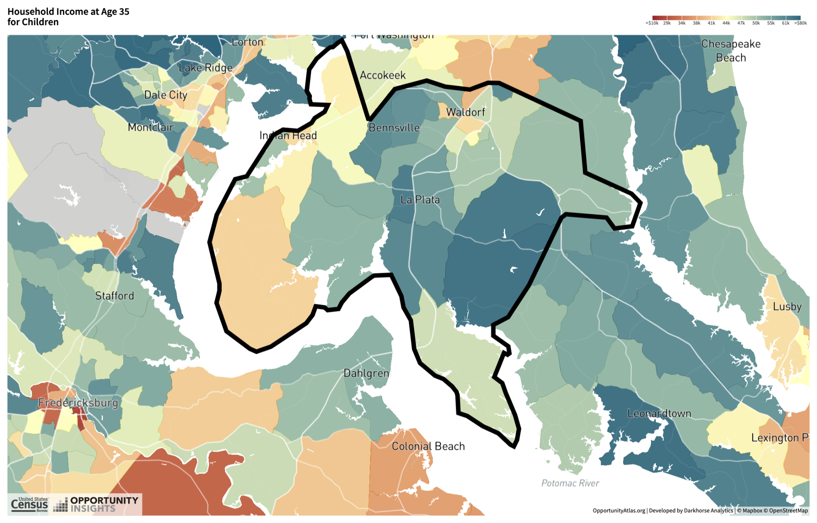
CHARLES COUNTY INCOME MOBILITY
CONNECTING AND CONVENING

Slide 15
Charles County: Children at Age 35 of Parents with Middle Income
CHARLES COUNTY
CHILDREN AT AGE 35 OF PARENTS WITH MIDDLE INCOME
 | White | Black Male | Black Female
Percent BA+ | .27 | .19 | .32
Household Income | $46,000 | $29,000 | $31,000
Individual Income | $29,000 | $26,000 | $25,000
CONNECTING AND CONVENING

Slide 16
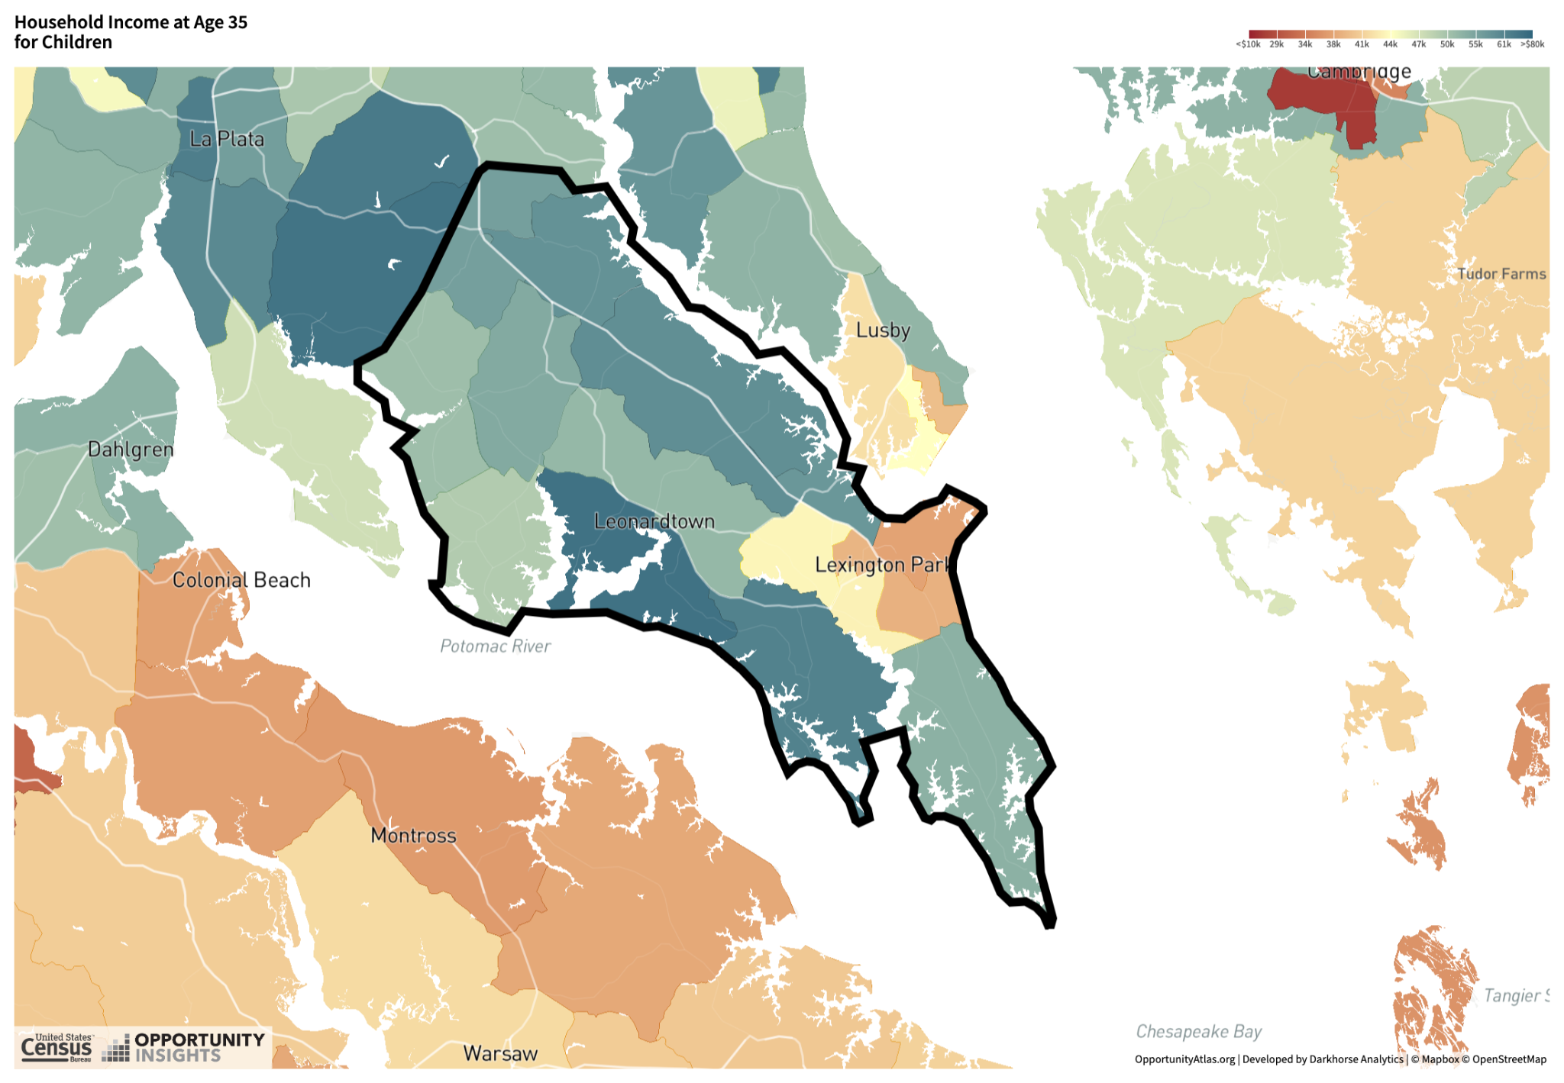
ST. MARY’S COUNTY INCOME MOBILITY
CONNECTING AND CONVENING

Slide 17
ST. MARY’S COUNTY
CHILDREN AT AGE 35 OF PARENTS WITH MIDDLE INCOME
 | White | Black Male | Black Female
Percent BA+ | .25 | .15 | .34
Household Income | $48,000 | $31,000 | $36,000
Individual Income | $31,000 | $28,000 | $30,000
CONNECTING AND CONVENING

Slide 18
CAN WE IMPROVE
MOBILITY AT CSM?
Framework: Access, Momentum, Mobility
What does the research say?
Challenges at each stage
Policy/Practice implications
CONNECTING AND CONVENING

Slide 19
CHALLENGES: ACCESS
Among high school students: Weak guidance and information, difficulties in key classes, weak CTE options
Financial burdens: Limited financial aid (Federal: Pell, IBR loans – noncredit?) and burdens of working (full-time)
Working out child care, transportation
CONNECTING AND CONVENING

Slide 20
CHALLENGES: MOMENTUM (COMPLETION)
LOW CC COMPLETION RATES: WHY?
Academic preparation – developmental education, course completion (esp. key gateway classes) – missing foundational skills
Expectations and nonlinear paths – time “wasted”
Institutional factors – FC v. NFC, academics v. workforce, governance
Life happens
CONNECTING AND CONVENING

Slide 21
CHALLENGES: UPWARD MOBILITY
Not just completion – but credentials with labor market value
Terminal Liberal Arts AAs: No real value (relative to HS)
On average: AAs>Certs, FC>NFC, LT>ST – but much variation by field of study, industry, variation in career mobility, too
CC engagement with regional employers – should be two-way street
CC transfers to four-year as well
Goal: Lots of successful pathways from which well-informed students choose what’s best for them (with appropriate guidance)
CONNECTING AND CONVENING

Slide 22
POLICY/PRACTICE IMPLICATIONS: ACCESS
Outreach to high schools: Labor market and academic info/guidance, pathways
Financial aid – Including not for credit – other sources (Short Pell, Federal Loans with IBR)
Financial Aid – WBL and work-study opportunities
Supports – help set up childcare and transportation – guidance
CONNECTING AND CONVENING

Slide 23
POLICY/PRACTICE IMPLICATIONS: MOMENTUM
Academics: Efficient and effective developmental education – focus on foundational skills (including digital)
Academics: Use data to identify students with needs – supportive tutoring, coaching
Academic guidance! (Guided Pathways?)
Emergency cash assistance and case management (stay the course)
CONNECTING AND CONVENING

Slide 24
POLICY/PRACTICE IMPLICATIONS: MOBILITY
Career Guidance – local labor market opportunities – where and what (American job centers)
Stackable credentials and pathways
Engagement with local employers – broad and deep – work-based learning options (apprenticeship), job placement
Transfer pathways, articulation
CONNECTING AND CONVENING

Slide 25
CAN CSM HELP RAISE MOBILITY? YES!
Outreach to HS, employers, four-year institutions
Institutional strengths: Pathways, guidance – do both academic and workforce well
Build on current successes!
Know strengths and weaknesses of counties
Awareness of challenges: What and who
Target assistance to who/where needed
CONNECTING AND CONVENING

