Slide 1
Understanding Title IX and Student Conduct at CSM: Things You Need to Know
Dr. Tracy Harris
Vice President, Student Equity and Success

Slide 2
Our Responsibilities
To ensure that you know and are aware of the Student Code of Conduct and Title IX legislation
Educate you about what is expected of you while on campus
To ensure a safe learning environment
To provide guidance and direction when needed
To support your academic journey to make you the best that you can be

Slide 3
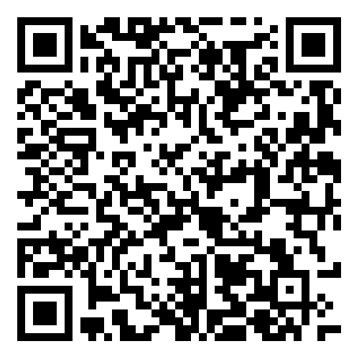
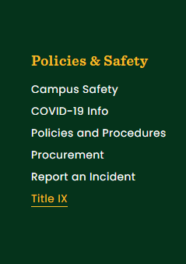
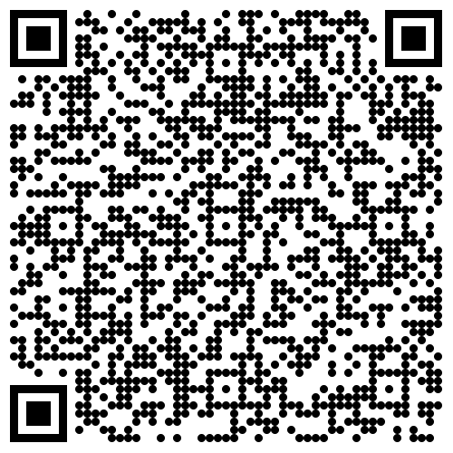
Student Code of Conduct and Title IX Legislation
Student Code of Conduct
To protect and preserve an environment conducive to educational excellence, the college has established the Student Code of Conduct and its associated processes to educate students of their academic, civic, and social responsibilities as individuals and as groups.
https://www.csmd.edu/studentaffairs
Title IX
This policy is enacted to prohibit sexual harassment, including sexual discrimination, sexual assault, domestic and dating violence, stalking, and retaliation; to establish complaint procedures to investigate allegations of violations of this policy; and to provide appropriate sanctions for violations of this policy.
https://www.csmd.edu/about/policies/policy-on-sexual-misconduct-relationships-violence-stalking-and-retaliation.html

Slide 4
Your Responsibilities and Consequences
Your Responsibilities
Consequences
Attend Classes
Engage with faculty and staff
If you see something, say something
Report concerning behavior
Know your rights as a CSM student
Be an active CSM Early College Student
Failing grades in courses
Disciplinary action (Student Code of Conduct)
Student Conduct Hearing
Suspension
Expulsion

Slide 5
Unacceptable behavior on a CSM campus
Disruptive behavior in or out of the classroom
Threatening Behavior in or out of the classroom
Any form of harassment to students or other individuals
Disrespectful conversation that does not support a positive learning environment
Academic Dishonesty (cheating, plagiarism, etc.)
Intentionally missing or skipping out of class
Not actively participating in college assignments and work

Slide 6
College Supports
Student Affairs
Academic and Career Advisors
Professional Counselors
Needs Coordinator
Mentoring support
Tutoring
Leadership Opportunities
Personal Enrichment
Student Life

Slide 7
While you are on a CSM Campus you should:
Value the experience and respect the learning environment
Take advantage of faculty, staff, and resources around you
If time permits, take advantage of college resources (tutoring, mentoring, PE, etc.)
Know your Resource people!
Dr. Forrest, ST 153 lmforrest@csmd.edu
Ms. Sylvia Royster, ST 153C, saroyster@csmd.edu
Dr. Harris, AD 207, taharris1@csmd.edu

